Slide 1
Time Speed
And
Distance

Slide 2
BASIC RELATIONS :
Let's foremost learn the definition of distance and time.
Distance: The numerical description of “How far two objects” is called distance. It may also refer to the length between two points that may be present or may get created.
Time: It is a component to compare the “durations of events” and the “intervals” between them and to quantify the motions of objects.
So, what is speed?
Suppose a man walks a distance of 10 kilometres and he takes 2 hours to walk the distance, the speed of the man is defined as the distance travelled by him in unit time. Here, we can say that the man travels 5 kilometres for every hour thereby completing the journey of 10 kilometres in 2 hours. The speed of the man is the rate at which he travels the specified distance.

Slide 3
The 3 formulas for Speed, Time & Distance:
Distance
Distance
Speed =
Time =
Distance =
Speed x
Time
Time
Speed
Solving for Speed
Solving for Time
Solving for Distance
Remember them from
this triangle:
D
S
T

Slide 4
A windsurfer travelled 28 km in 1 hour 45 mins.
Calculate his speed.
Distance
Speed =
D
Time
S
T
28
=
1•75
1 hour 45 mins
= 16 km/h
Answer: His speed was 16 km / hour

Slide 5
A salesman travelled at an average speed of 50 km/h for 2 hours 30 mins. How far did he travel?
D
Distance =
Speed x Time
S
T
= 50 x 2•5
2 hour 30 mins
= 125 km
Answer: He travelled 125 km

Slide 6
A train travelled 555 miles at an average speed of 60 mph. How long did the journey take?
Distance
D
Time =
Speed
S
T
555
=
60
= 9•25 hours
= 9 hours 15 mins
Answer: It took 9 hours 15 minutes

Slide 7
UNITS OF SPEED AND THEIR CONVERSION
Standard Units
The standard units of speed are as follows.
Unit Symbols
metres per second m/s
kilometres per hour km/h
miles per hour m/h
1 kilometre = 1000 metres
1 mile = 1.60934 kilometres or 1.6 kilometres
1 hour = 3600 seconds

Slide 8
Conversion of units from km/h to m/s and vice versa
1 km/h = 1000m / 3600s = 5m / 18s
So,
1 km/h = 5/18 m/s and 1 m/s = 18/5 km/h
1 km/h = 50/3 m/min and 1 m/min = 3/50 km/h

Slide 9
Example: A person crosses a 600 m long street in 5 minutes. What is his speed in km per hour?
3.6
7.2
8.4
10

Slide 10
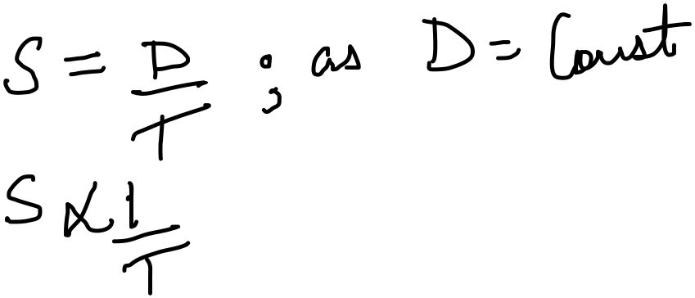
PROPORTIONALITY :
Distance is constant, Speed and Time are inversely proportional
As Speed is inversely proportional to Time
Therefore If Speed increases Time of the journey decreases
Or
If Speed decreases then Time of the journey increases

Slide 11
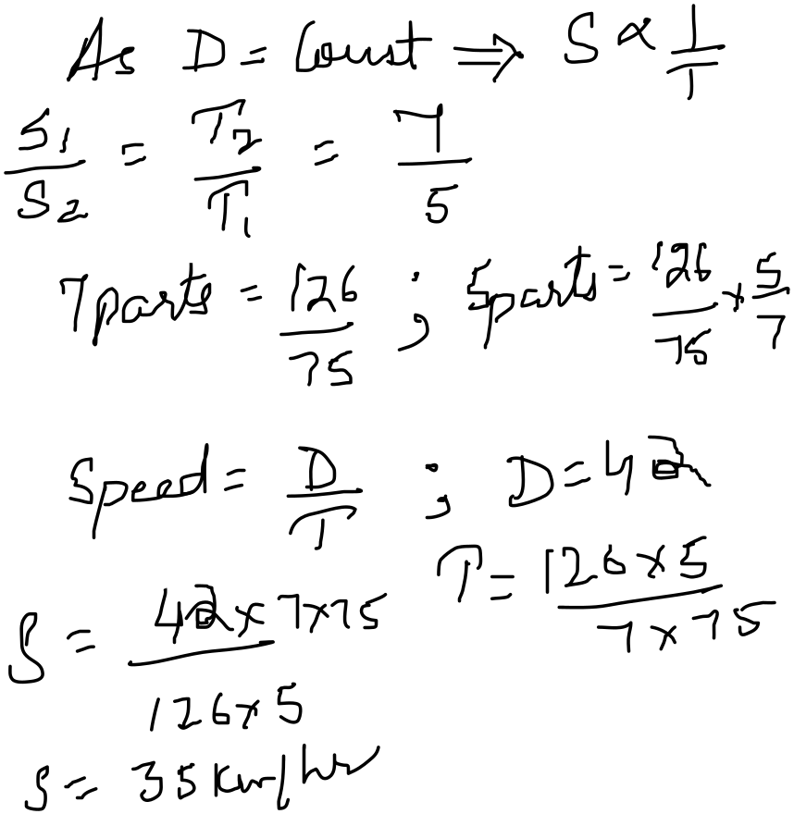

A car travelling with 5/7 of its actual speed covers 42 km in 1 hr 40 min 48 sec. Find the actual speed of the car
Time taken = 1 hr 40 min 48 sec = 1 hr 40 4/5 min = 126/75 hrs Let the actual speed be A km/hr. S=D/T S*T=D Then (5/7) * A*(126/75) = 42 A= 35km/hr

Slide 12
Ajay takes 3 hours to travel from City A to City B at his normal speed. However, he can travel the same distance in 2 hours by travelling at 'x' km/h. Find the normal speed of Ajay if the difference between the speeds is 20 km/h.

Slide 13
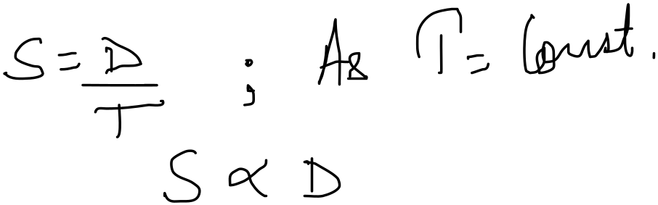
(ii) Time is constant, Speed and Distance are directly proportional
Therefor, Faster the speed more will be the distance travelled
OR
Slower the speed less will be the distance travelled

Slide 14
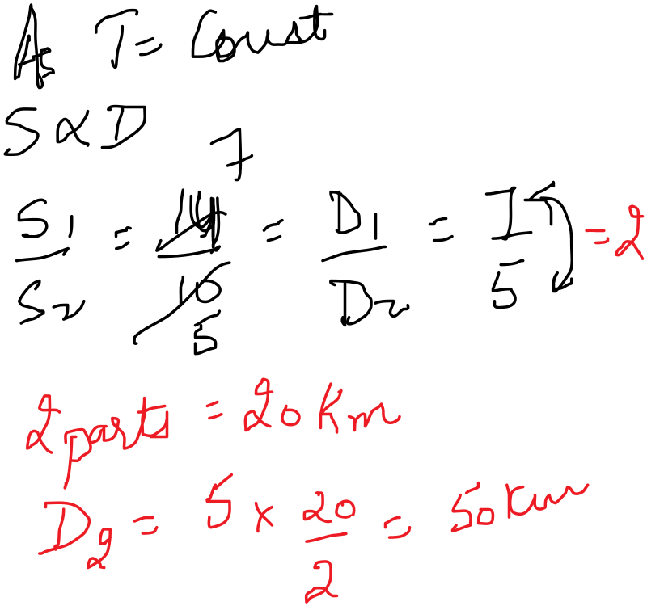


If a person walks at 14 km/hr instead of 10 km/hr, he would have walked 20 km more. The actual distance travelled by him is:
Let the actual distance travelled be x km.
Then, x/10 = (x+20) / 14
⇒14x=10x+200
⇒4x=200
⇒x=50km

Slide 15
Two cars start from A and B travel towards each other at speeds of 50 km/h and 60 km/h respectively. At the time of their meeting, the second car has travelled 12 kms more than the first. Find the distance between A and B.

Slide 16
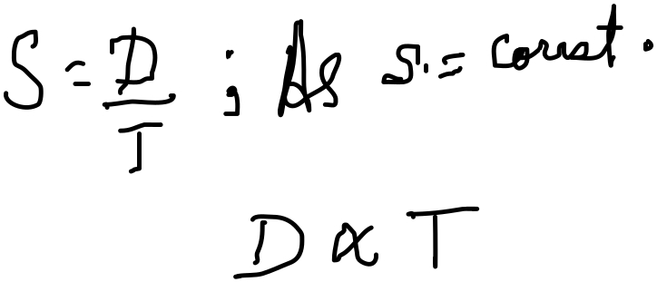
(iii) Speed is constant, Time and Distance are directly proportional
Like Distance is directly proportional to Time
Therefore, if the distance travelled increases time also increases
OR
if the distance travelled decreases time also decreases

Slide 17

AVERAGE SPEED
What is the Average Speed Formula?
The average speed of a body is equal to the total distance covered, divided by the total time taken. The average speed formula is expressed as follows:
Average Speed Formula

Slide 18
Average Speed Formula with Two Speeds
The average speed formula with two speeds can be calculated after adding the total distance and dividing it by the total time taken to cover that distance.
Now, if two speeds are given along with the time taken by them, we will have to find the two distances.
We find the distance covered by using the formula, Distance = Speed × Time.
After this, we add the two distances and divide it by the total time.
Let us understand this with the help of an example.
Example: During a journey, a train moves at a speed of 50 kilometers per hour for the first 2 hours and 70 kilometers per hour for the next 3 hours. Find the average speed of the train using the average speed formula.
Solution:
We know that the train moves at a speed of 50 kilometers per hour for the first 2 hours. So, speed₁ = 50, time₁ = 2
And the train moves at a speed of 70 kilometers per hour for the next 3 hours. So, speed₂ = 70, time₂ = 3

Slide 19
We will use the following steps to solve the question.
First, we will the Distance₁ and Distance₂ separately using the formula, Distance = Speed × Time.
We know that total distance = (Distance₁ + Distance₂)
We know that total time = (Time₁ + Time₂)
Average Speed Formula = Total Distance/Total Time
Average Speed = (Distance₁ + Distance₂) ÷ (Time₁ + Time₂)
Applying all these steps together we get,
Average Speed = (50 × 2 + 70 × 3) ÷ (2 + 3)
= (310) ÷ (5) = 62 kilometer/hour
Therefore, the average speed of the train is 62 kmph.

Slide 20
A train is moving with a speed of 80 miles per hour for the first 4 hours and 110 miles per hour for the next 3 hours. Find the average speed of the train with the help of the average speed formula.

Slide 21
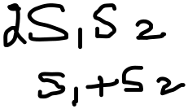
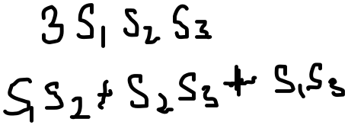
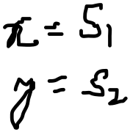
Case 1 – When the distance is constant:
Two speeds S₁ and S₂ are given
Average speed =
Two speeds S₁,S₂ and S₃ are given
Average speed =
Case 2 – When the time taken is constant:
Average speed = (x + y)/2;

Slide 22
If the car had gone from A to B at 50 kmph and returned from B to A at 60 kmph, what would be the average speed?

Slide 23
A boy goes to school at a speed of 3 km/hr and returns to village at 2 km/hr. If he takes 5 hours, what is the distance between the school and the village?

Slide 24
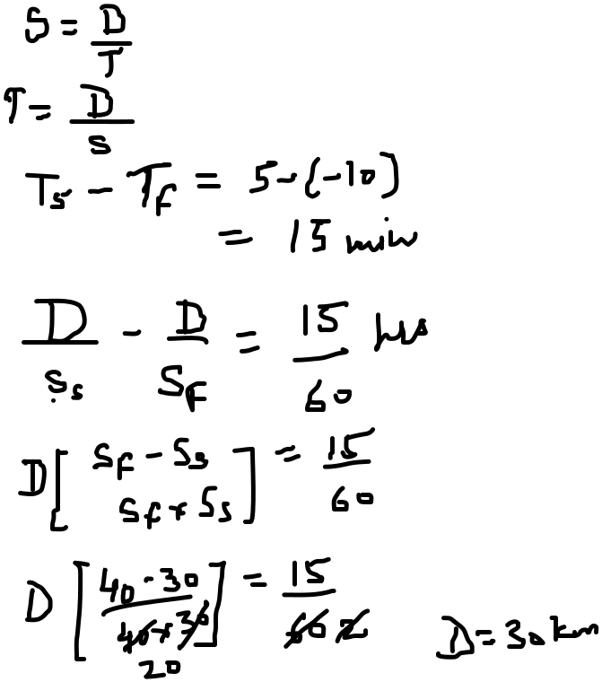

A man covers a certain distance between his house and office on bike. Having an average speed of 30 km/hr, he is late by 10 minutes. However, with a speed of 40 km/hr, he reaches his office 5 minutes earlier. Find the distance between his house and office?
METHOD 1
Difference in time;
10+5 = 15 minutes => 15/60 hours
=> 0.25 hours
The required distance
= (30×40)x0.25/(40-30) = 30 km
METHOD 2
METHOD 3
Speed Ratio = 3 : 4
Time Ratio = 4 : 3
diff = 1 part
= 15 min
Hence time taken
= 60 min & 40 min
Distance = S*T
=> 30*1 = 30 km

Slide 25

Finding Speed or Time Required after Crossing Each Other:
Application:
If two persons or trains A and B start their journey at the same time from two points P and Q towards each other and after crossing each other they take a and b hours in reaching Q and P respectively, then
Note: Using this relationship you can find out the missing variables which can be either speed or time. Once these are known you can easily find the distance.

Slide 26
Two, trains, one from Howrah to Patna and the other from Patna to Howrah, start simultaneously. After they meet, the trains reach their destinations after 9 hours and 16 hours respectively. The ratio of their speeds is:
Solution:
The ratio of their speed is √16/√9 = 4/3 or 4:3

Slide 27
Practice Questions:
1. A man covers a certain distance by car driving at 30kmph and he returns back to the starting point with a speed 40kmph. Find his average speed for the whole journey.
35 km/hr
34.3 km/hr
36 km/hr
None
Ans: B

Slide 28
2. The ratio between the speeds of two trains is 7 : 8. If the second train runs 400 km in 4 hours, What is the speed of the first train?
85km/hr
87.5 km/hr
90 km/hr
None

Slide 29
3. A truck covers a distance of 550 meters in 1 minute whereas a train covers a distance of 33 kms in 45 minutes. What is the ratio of their speed?
a) 4:3
b) 3:4
c) 5:4
d) None
Ans: B

Slide 30
4. A person has to cover a distance of 6 km in 45 minutes. If he covers one-half of the distance in two-thirds of the total time; to cover the remaining distance in the remaining time, what should be his speed in km/hr?
10 km/hr
12 km/hr
15 km/hr
None
Ans: B

Slide 31
5. A man travels the first part of his journey at 30 kmph and the remaining part at 90 kmph, and he covers the entire journey at an average speed of 50 kmph. What is the ratio of the distance he covered at 30 kmph to that he covered at 90 kmph?
1 : 2
1 : 3
2 : 3
3 : 4
Ans: C

Slide 32
6. Ram starts from Ludhiana at 6 a.m. at a constant speed of 40 kmph. He halts at Jalandhar for half an hour and then drives at 70 kmph. He reaches Amritsar at 9.30 a.m. which is 180 km away from Ludhiana. What is the distance between Jalandhar and Amritsar?
120 km
140 km
100 km
130 km
Ans: B

Slide 33
7. While driving from Chennai to Bangalore, I covered half of the journey at an average speed of 80 kmph, half of the 2nd half of the journey at an average speed of 40 kmph and the rest at 60kmph. It took 5 hours and 30 minutes to reach Bangalore. How far is Bangalore from Chennai?
310 km
350 km
330 km
360 km
Ans: C

Slide 34
8. There are 20 windmills with a constant distance between each pole. A car takes 22 seconds to reach the 12th pole. How much time will it take to reach the last pole?
36 seconds
38 seconds
40 seconds
42 seconds
Ans: B

Slide 35
9. A was travelling in a bus. After going 2/3rd of the total distance, the bus broke down. So he hired an auto and completed the rest of the journey. He found that the auto took twice the time the bus took. Find the ratio of the speed of the bus to that of the auto.
1 : 2
2 : 1
3 : 1
4 : 1
Ans: D

Slide 36
10. By walking at 3/7th of his usual speed, a man reaches office 20 minutes later than usual time. What is his usual travel time?
10 min
15 min
20 min
25 min
Ans: B

Slide 37
11. Two buses travel to a place at 45 km/h and 60 km/h respectively. If the second bus takes 5 1/2 hours less than the first for the journey, the length (all in km) of the journey is
900
945
990
1350
Ans: C

Slide 38
12. A ship went on a voyage. After 180 miles a plane started with 10 times speed that of the ship. Find the distance when they meet from starting point.
185 miles
190 miles
200 miles
220 miles
Ans: C

Slide 39


